Slide 1
Support Engineers Rostering
Team 35 Pitch

Slide 2
Outline
Team introduction
Members' team roles allocation.
Proposed approach
How to develop this project, front-end and back-end.
Technical Analysis
Specific problems and solutions, technique points of developing.
Team skills
Our strengths, relevant skills and experiences.
Summary
Notes:
This slide would be what we’re going to talk about in this pitch – should take about 1 minute

Slide 3
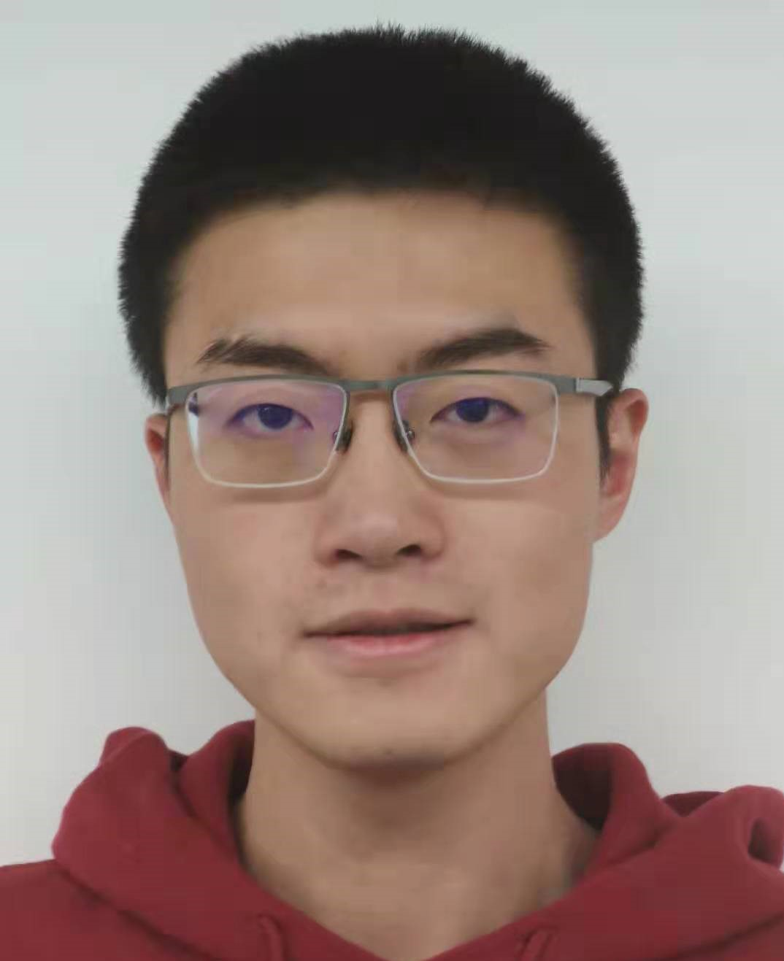
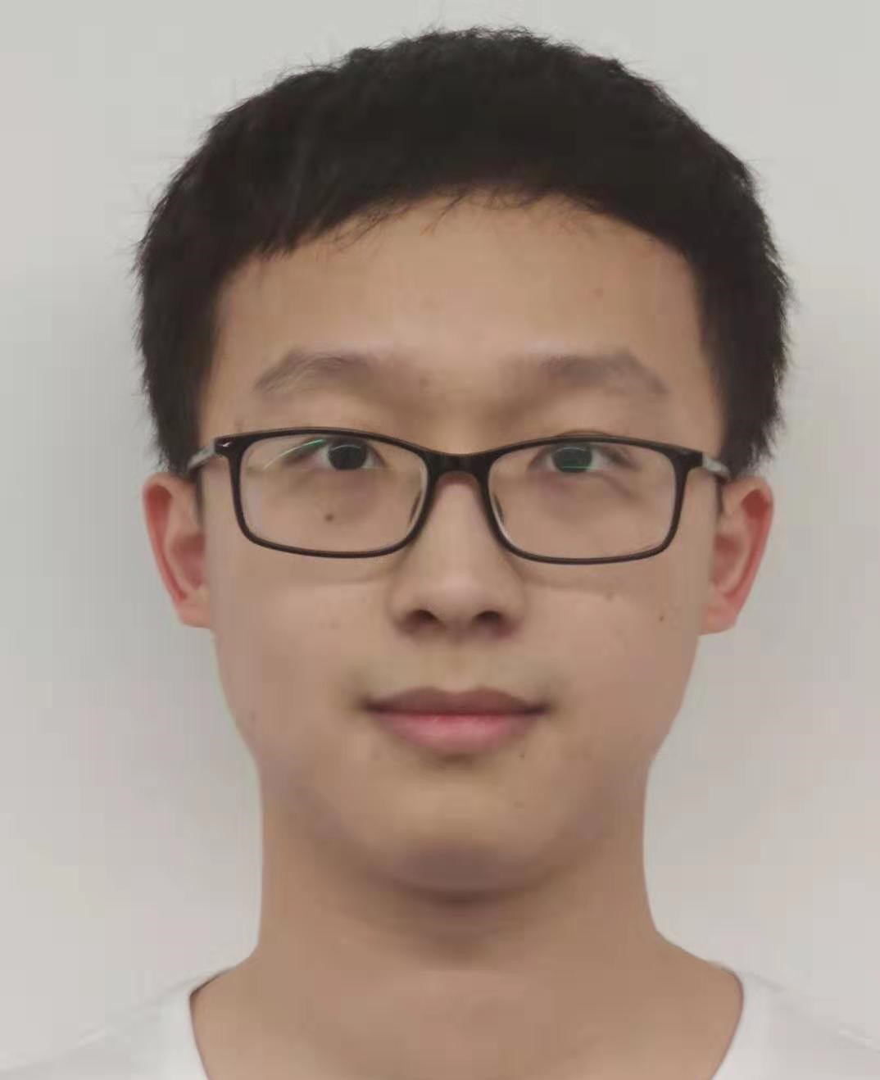
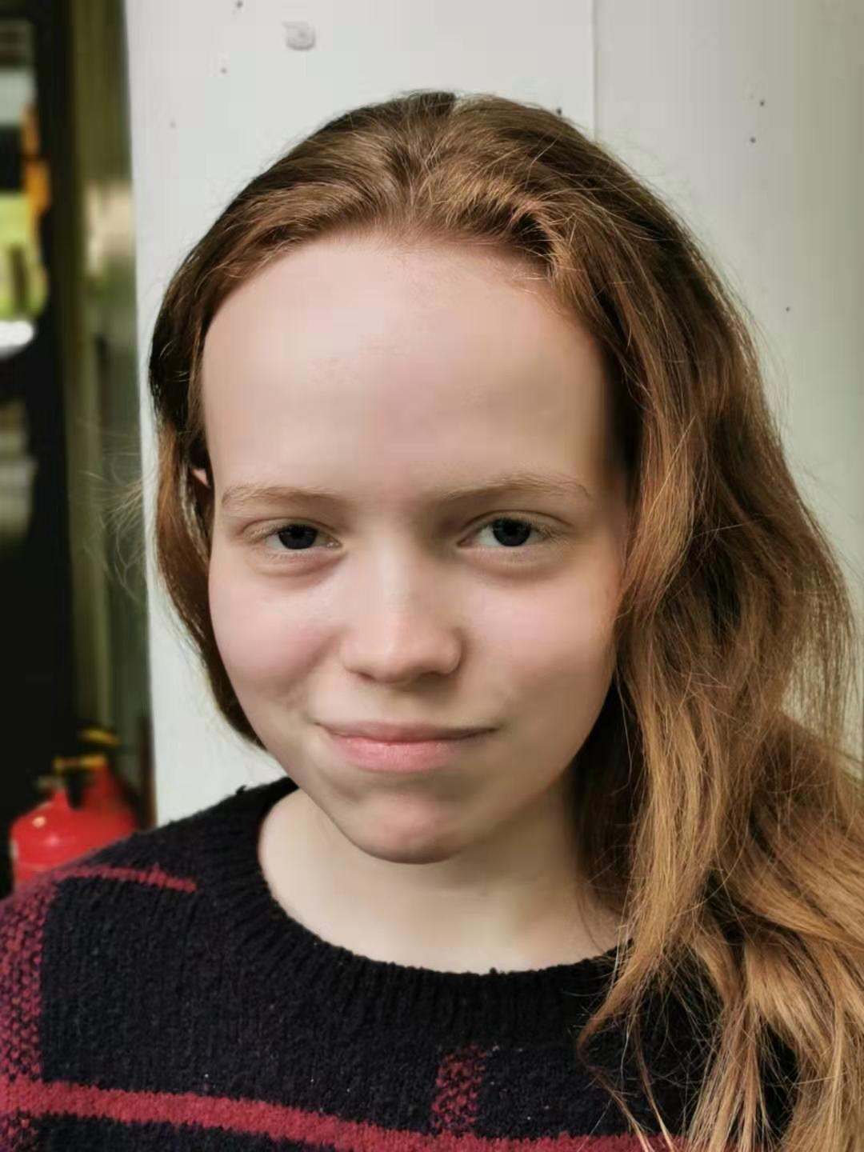
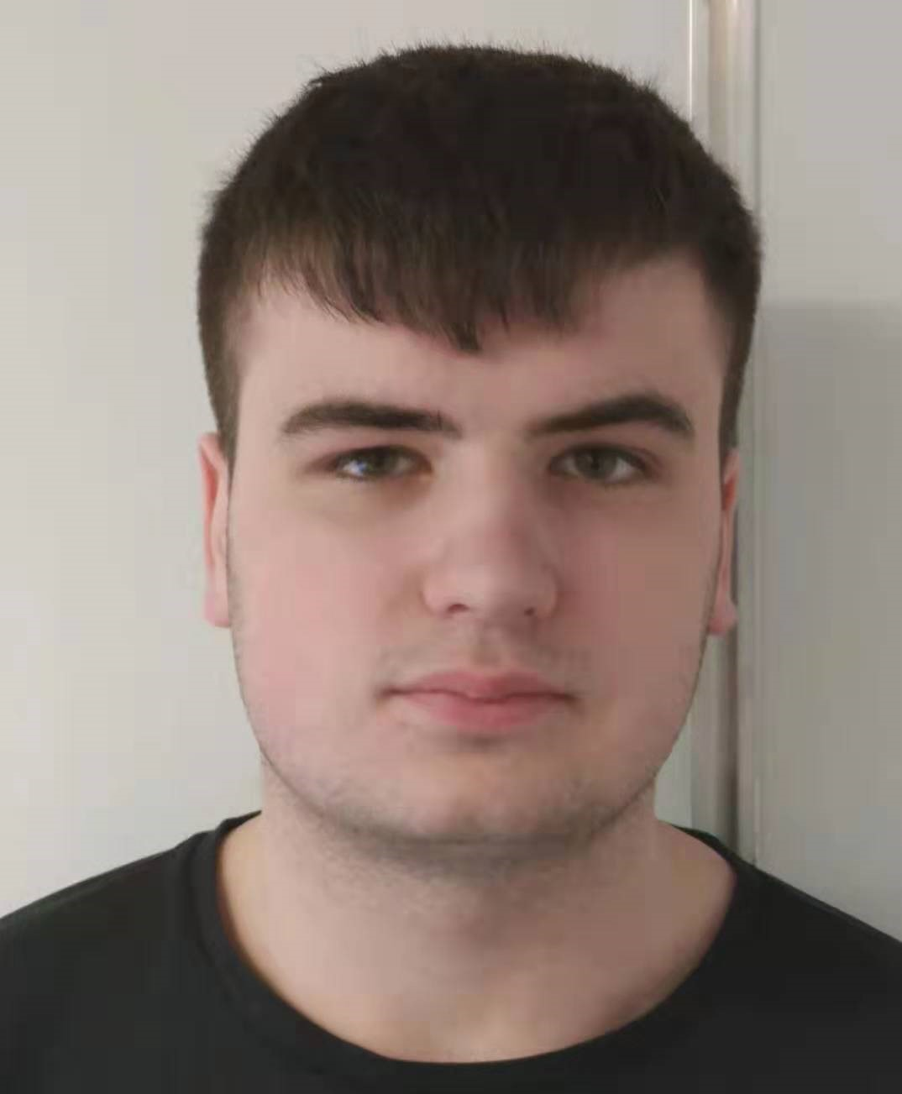
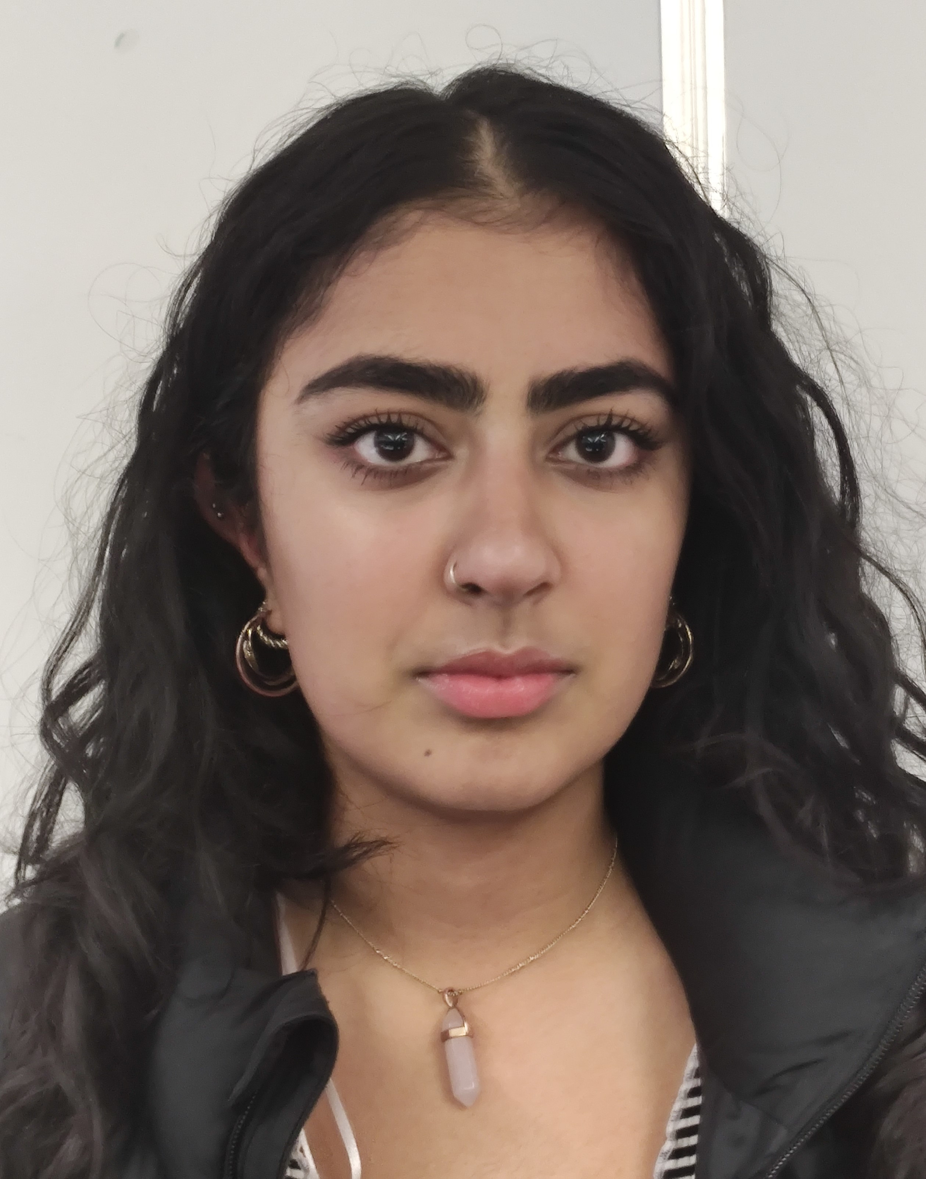
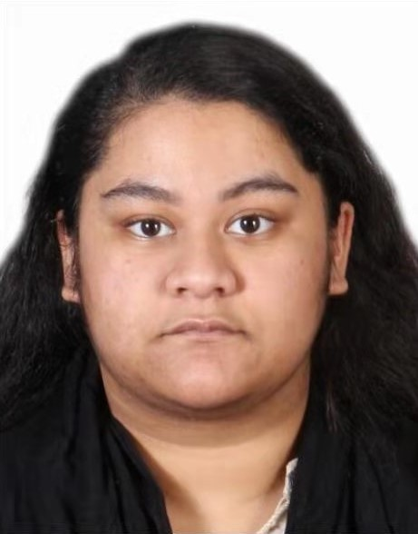
Team roles
Kejia Wu
Team Leader
Xuanhao Li
Nicole Millinship
Team Administrator
Liam Orrill
Gurjyot Kaur
Git Master
Tasnuva Tajin
Notes:
This slide explains everyone’s role in the project and what their skills are. It should also take 1 minute
We should use the same layout as Kobe and Leo's galaxian team slide and have a picture for each team member – this means that we don't need everyone to introduce themselves and waste time

Slide 4
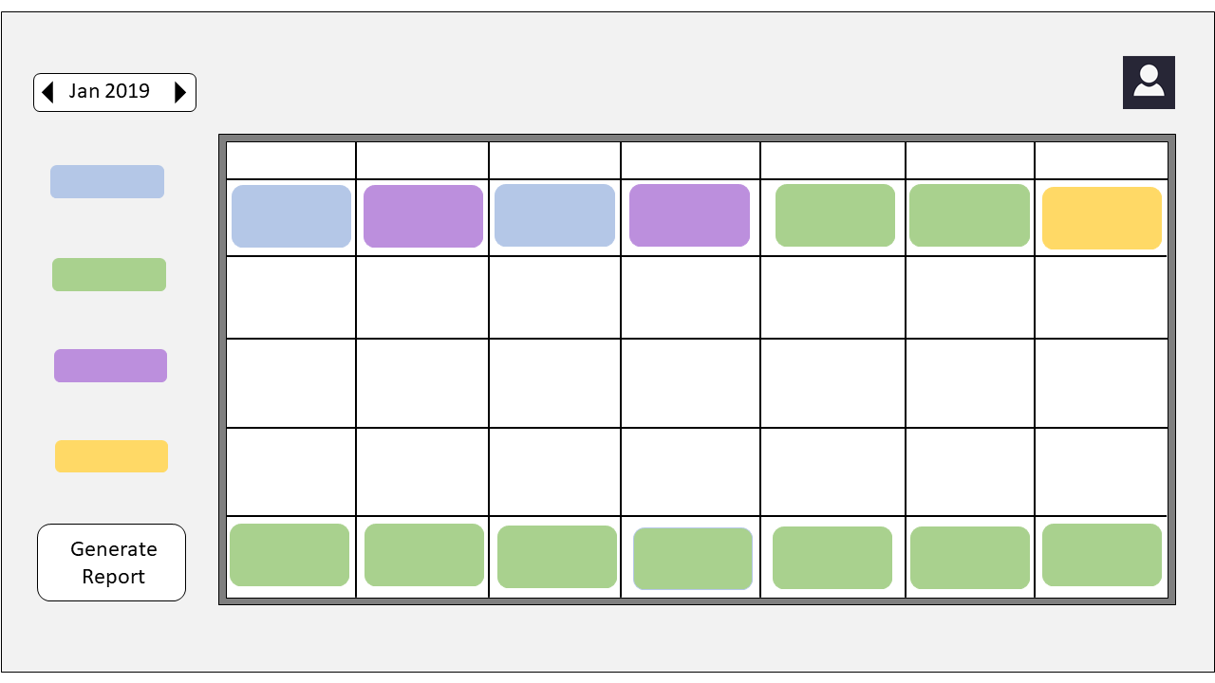
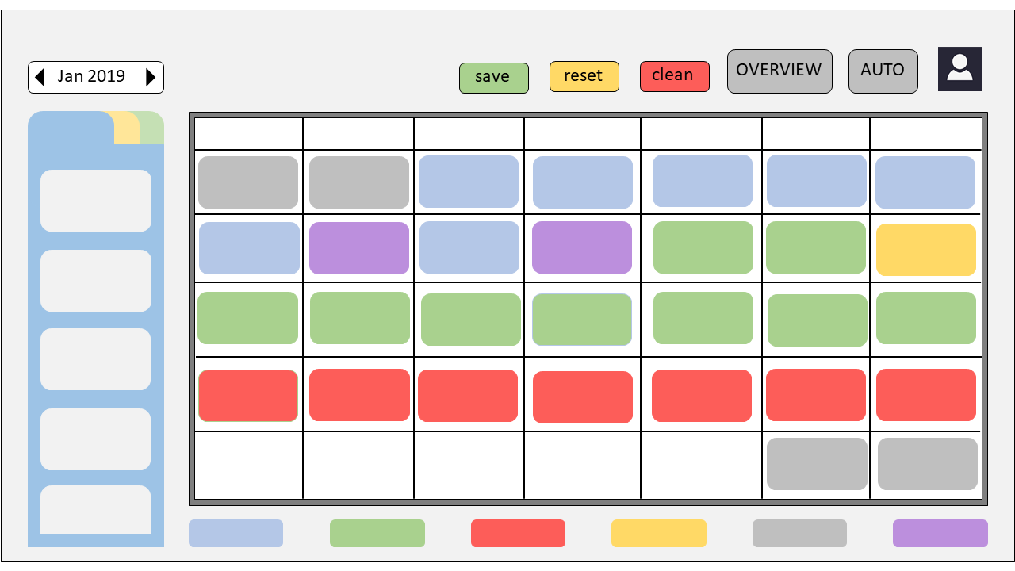
Proposed approach
Splitting project into 3 stages:
Rostering System and UI's
Creating the email system
Implementing AI methods to improve the system
Employee Interface
Administrator Interface

Slide 5


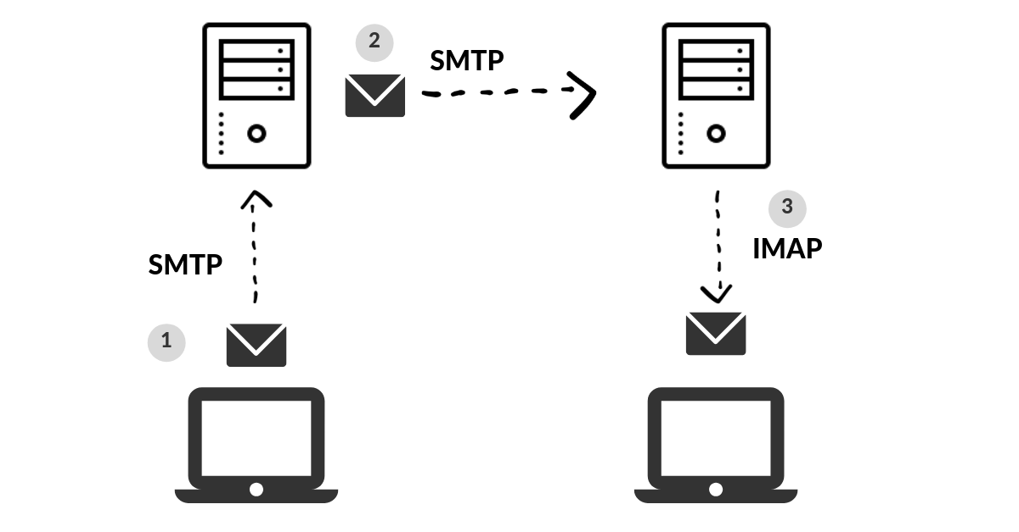
Technical analysis
Languages:
PHP, JavaScript, SQL (MySQL)
Designing:
HTML5, CSS3
Email Protocols:
SMTP (On PHP) (IMAP?)
AI Methods:
Heuristic search

Slide 6
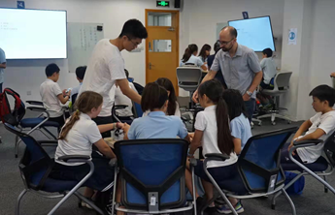
Team Skills
Technical Skills
Have experience in developing websites (Hotel & Movie)
Have learned Java at university in the last year
Applied AI methods previously and know heuristics search
Learned about HCI concepts and how to apply them
Teamwork
Tajin works in IT service
Liam plays in university sports team
Keija and Gurjyot have business working experience
Strong experience in agile

Slide 7
Summary
Our team proposed to create this project using PHP, JavaScript (Java considered)
Created clear strategy to implement website HCI and functions
Experience with creating web applications and functional websites
Have good understanding of DevOps and agile development method
Thank you for listening

